Slide 1
A new synthetic data set for tax policy analysis
The Policy Simulation Library DC meeting
The American Enterprise Institute Washington, DC, November 26, 2019
Don Boyd, Co-Director
State and Local Government Finance Project, Center for Policy Research
Consultant to the AEI Open Source Policy Center
View or download at github donboyd5: github.com/donboyd5/slides
Based on work done jointly with Max Ghenis, Consultant to the AEI Open Source Policy Center, and Dan Feenberg, National Bureau of Economic Research

Slide 2
Motivation
Income tax policy models need a microdata input file that represents the population of interest
PSL TaxData prepares & enhances 2 such files for Tax-Calculator:
A PUF-based version that enhances the IRS Public Use File
A CPS version that enhances the Current Population Survey
Enhanced PUF represents taxpaying universe well for many purposes. (Does not include non-taxable benefits. And not perfect.)
PUF costs ~$10k and requires legal agreement.
CPS is missing important income components & does not represent high-income taxpayers well. Tax liability differences vs. PUF can be significant (e.g., 20%). However, CPS-based file includes non-taxable benefits -- important for some analyses.

Slide 3
Synthetic data
Data “created” by means other than direct measurement - e.g., by algorithm. Intended to preserve key statistical characteristics of true data: means, variances, correlations, patterns of missingness, while not containing confidential information that must be suppressed.
“Fully synthetic” data have no real data (unlike data with imputations).
Goals - non-confidential data that mimic true data well enough that:
Analysts can practice and learn how to use a restricted-access confidential data source.
Analysts can test out programs and get “pretty good” results prior to using confidential “gold standard” data in a safe (restricted) environment.
Holy Grail: Results can be treated as if they are based on gold-standard data. (Not clear whether/when this can be done.)
Ex: Synthetic versions of Longitudinal Business Database, SIPP

Slide 4
Free unrestricted synthetic tax data can allow:
Much wider use given that it is free
Testing of programs without restriction
Desktop analysis of federal income tax policies
Students, professors -- public policy, economics
Fiscally oriented data journalists
Cash-strapped nonprofit fiscal analysis groups
State policymakers/advisers concerned about federal tax impacts
No blurring of Tax-Brain results
Ability to focus TaxData resources on a single data approach
Spinoff state-specific synthetic data files
Another OSPC-incubated project: Could allow analysis of state income taxes, as well as federal tax impact on a state

Slide 5
Our goals are to create synthetic tax data that:
Can satisfy IRS/SOI disclosure review
Can be made available for free
Without legal agreements
Is usable as input to tax-calculator models
Is useful for some kinds of tax policy analyses
We can identify good uses for, and dangerous uses
We have a version that fully satisfies 1-3 and partially satisfies 4-6.
We are learning how to improve it, and plan to do so.

Slide 6
This is different from and complements the Tax Policy Center’s project on synthetic data
TPC project is far more extensive: substantial edits to underlying IRS and SSA data and construction of a far larger fully synthetic PUF directly from source tax data; many more schedules and items than current PUF.
TPC synthetic PUF likely to be richer and more faithful to tax data.
Our project is limited to creating synthetic data directly from current PUF, and data will be available much sooner.
Depending on how the projects evolve a TPC fully synthetic PUF, when ready, could be an improved replacement for synthetic data we create.

Slide 7
Steps in the process
Create synthetic data file (details in a minute)
Evaluate file quality
Ensure that it meets IRS SOI non-disclosure requirement
NOTE: the file is not produced or endorsed by IRS/SOI in ANY way. It simply passes their disclosure review.
Construct weights for the file
Enhance the file via TaxData
Test, test, test, test
Use cautiously for selected purposes
Improve.

Slide 8
Constructing synthetic files

Slide 9
Synthesis steps
Create one or more “seed” variables
Construct synthetic records, variable by variable:
Construct a model for the variable using only RHS variables that have been modeled or “seeded”
Predict synthetic values for the variable based upon predicted values of variables modeled so far
Repeat until all variables are synthesized

Slide 10
Sequential synthesis approach (simplified)
Seed
Retained as-is in the synthesis
Calculated seed
Used for synthesis, later discarded
Synthesized variables
Generated from the conditional distribution
ID | MARS | AGI | Wages | Dividends
1 | Single | $70,000 | $65,000 | $1,000
2 | Married | $40,000 | $40,000 | $0
3 | Married | $200,000 | $130,000 | $40,000

Slide 11
Sequential synthesis approach (simplified)
Step 1
Copy the seed variables over
Optional: sample with replacement
ID | MARS | AGI | Wages | Dividends
1 | Single | $70,000 | $65,000 | $1,000
2 | Married | $40,000 | $40,000 | $0
3 | Married | $200,000 | $130,000 | $40,000
TRUE
ID | MARS | AGI | Wages | Dividends
1 | Single | $70,000
2 | Married | $40,000
3 | Married | $200,000
SYNTH

Slide 12
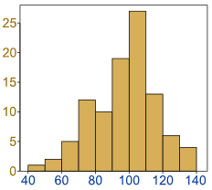
Sequential synthesis approach (simplified)
Step 2
Determine the conditional distribution of the first synthesized variable
ID | MARS | AGI | Wages | Dividends
1 | Single | $70,000 | $65,000 | $1,000
2 | Married | $40,000 | $40,000 | $0
3 | Married | $200,000 | $130,000 | $40,000
TRUE
Predicted distribution of wages conditional on MARS and AGI
ID | MARS | AGI | Wages | Dividends
1 | Single | $70,000
2 | Married | $40,000
3 | Married | $200,000
SYNTH
Wages

Slide 13
Sequential synthesis approach (simplified)
Step 3
Impute the first synthesized variable by selecting randomly from the predicted conditional distribution
ID | MARS | AGI | Wages | Dividends
1 | Single | $70,000 | $65,000 | $1,000
2 | Married | $40,000 | $40,000 | $0
3 | Married | $200,000 | $130,000 | $40,000
TRUE
Predicted distribution of wages conditional on MARS and AGI
ID | MARS | AGI | Wages | Dividends
1 | Single | $70,000 | $62,400
2 | Married | $40,000 | $40,000
3 | Married | $200,000 | $155,100
SYNTH
Wages

Slide 14
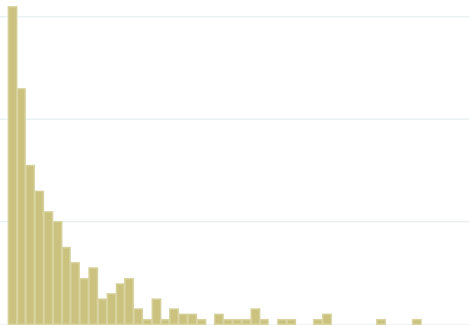
Sequential synthesis approach (simplified)
Step 4
Do steps 2-3 for subsequent variables, conditional also on previously synthesized values
ID | MARS | AGI | Wages | Dividends
1 | Single | $70,000 | $65,000 | $1,000
2 | Married | $40,000 | $40,000 | $0
3 | Married | $200,000 | $130,000 | $40,000
TRUE
Predicted distribution of dividends conditional on MARS, AGI, and wages
ID | MARS | AGI | Wages | Dividends
1 | Single | $70,000 | $62,400 | $0
2 | Married | $40,000 | $40,000 | $0
3 | Married | $200,000 | $155,100 | $43,900
SYNTH
Dividends

Slide 15
Sequential synthesis approach (simplified)
Step 5
Drop the calculated seeds
Recalculate after synthesizing all variables
ID | MARS | AGI | Wages | Dividends
1 | Single | $70,000 | $65,000 | $1,000
2 | Married | $40,000 | $40,000 | $0
3 | Married | $200,000 | $130,000 | $40,000
TRUE
ID | MARS | AGI | Wages | Dividends
1 | Single |  | $62,400 | $0
2 | Married |  | $40,000 | $0
3 | Married |  | $155,100 | $43,900
SYNTH

Slide 16
Specific data and methods choices
Data: 2011 raw PUF. Delete the 4 aggregate records. Select and synthesize 65 variables (55 continuous, 10 categorical) needed for Tax-Calculator.
Enforce relationships:
Separately synthesize pensions and annuities included in AGI (e01700) and those not included; construct their sum (e01500).
Use a variant on this approach for qualified and ordinary dividends.
Seeds:
Use marital status and record weight as is
Use 9 additional variables on RHS for all estimations/predictions but drop from output: AGI (e00100), exemption amount (e04600), deduction amount (p04470), taxable income (e04800), AMT income (e62100), income tax before credits (e05800), income tax after credits (e08800), earned income for the EIC (e59560), and non-passive income (e26190). Much later, calculate from components.
Visit sequence: largely is descending size by sum of weighted values in PUF
Output: 5x as many synthetic records as PUF records -- 750-800k records

Slide 17
We use random forests to predict
Has been shown to perform well
Works well without a lot of tuning or labor
Has outperformed (slightly) our CART (classification and regression tree) efforts, especially in “sparse” areas of the data
We use the synthimpute Python package (written by Max Ghenis)
200 trees
14.5 hours on an Intel Core i7

Slide 18
Other approaches merit consideration
Our methods are used widely and work well with large data files
Econometric approaches, quantile regression, and related methods can be useful, often in two stages (e.g., TPC, Census):
Predict whether a variable is nonzero
Predict its value or distribution
Generative Adversarial Networks (GANs): deep learning methods in which a data-generating neural net communicates with a data-discriminating neural net; potential value re: differential privacy
Methods require choices about hyperparameters, functional form
These are on our radar screen and are longer-term possibilities

Slide 19
Disclosure review

Slide 20
Disclosure review
By definition and design, synthesized records are not actual data. Every record is constructed from a model, not by adding noise to data.
However, it is possible to produce by chance a synthesized record that matches a PUF record on all variables. This is more likely to occur for a trivially simple record that occurs multiple times in the data set, such as a record for which all income and deduction variables are zero, than for a complex record that is unique.
We were asked to follow the rule below. We followed this rule and obtained certification that the file meets this requirement:
Rule: No synthesized record may match any unique PUF record, exactly, on every synthesized variable.

Slide 21
Evaluating the synthetic file (before weighting)

Slide 22
Examining synthesis results (unweighted)
Individual variables
Complicated: Many zero-values, highly skewed distributions
Examine percentage of values that are zero
Statistics that describe the variable and its distribution
Extent to which PUF and synthetic distributions overlap
Relationships among variables
Correlations
Plots of continuous variable by categorical variable groupings (e.g., by marital status)

Slide 23
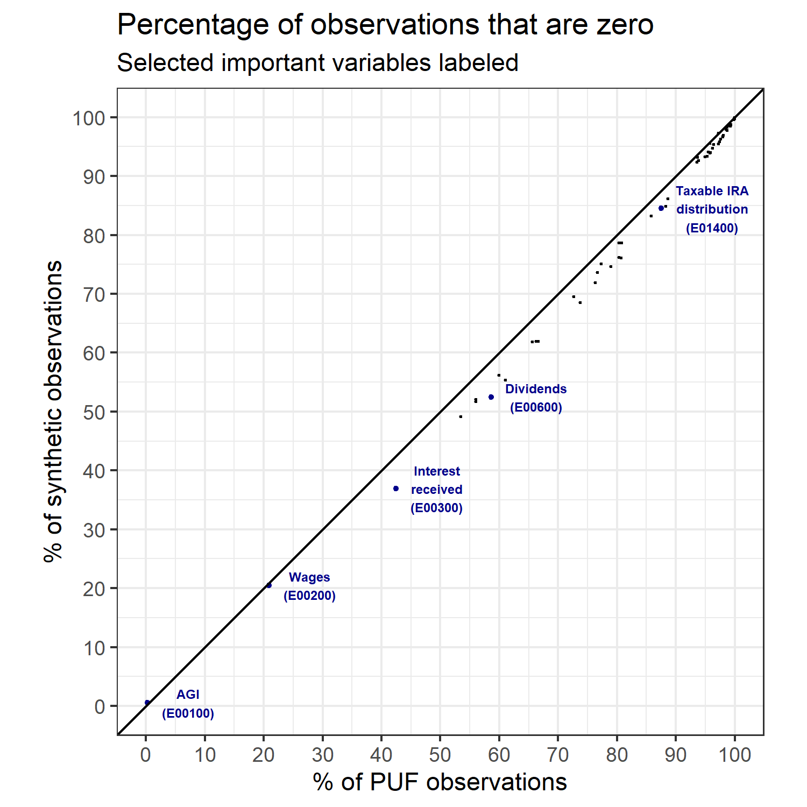
We (slightly) under-synthesize zero-values
Each observation (dot) in the scatterplot is one of our 55 continuous variables
The horizontal axis is the % of this variable’s values in the PUF that are zero
The vertical axis is the % of this variable’s values in the synthetic file that are zero
If a dot is on the 45-degree line, then synthetic and PUF files have the same % of observations that are zero.
Below the line means the synthetic file has a smaller % of nonzero values.

Slide 24
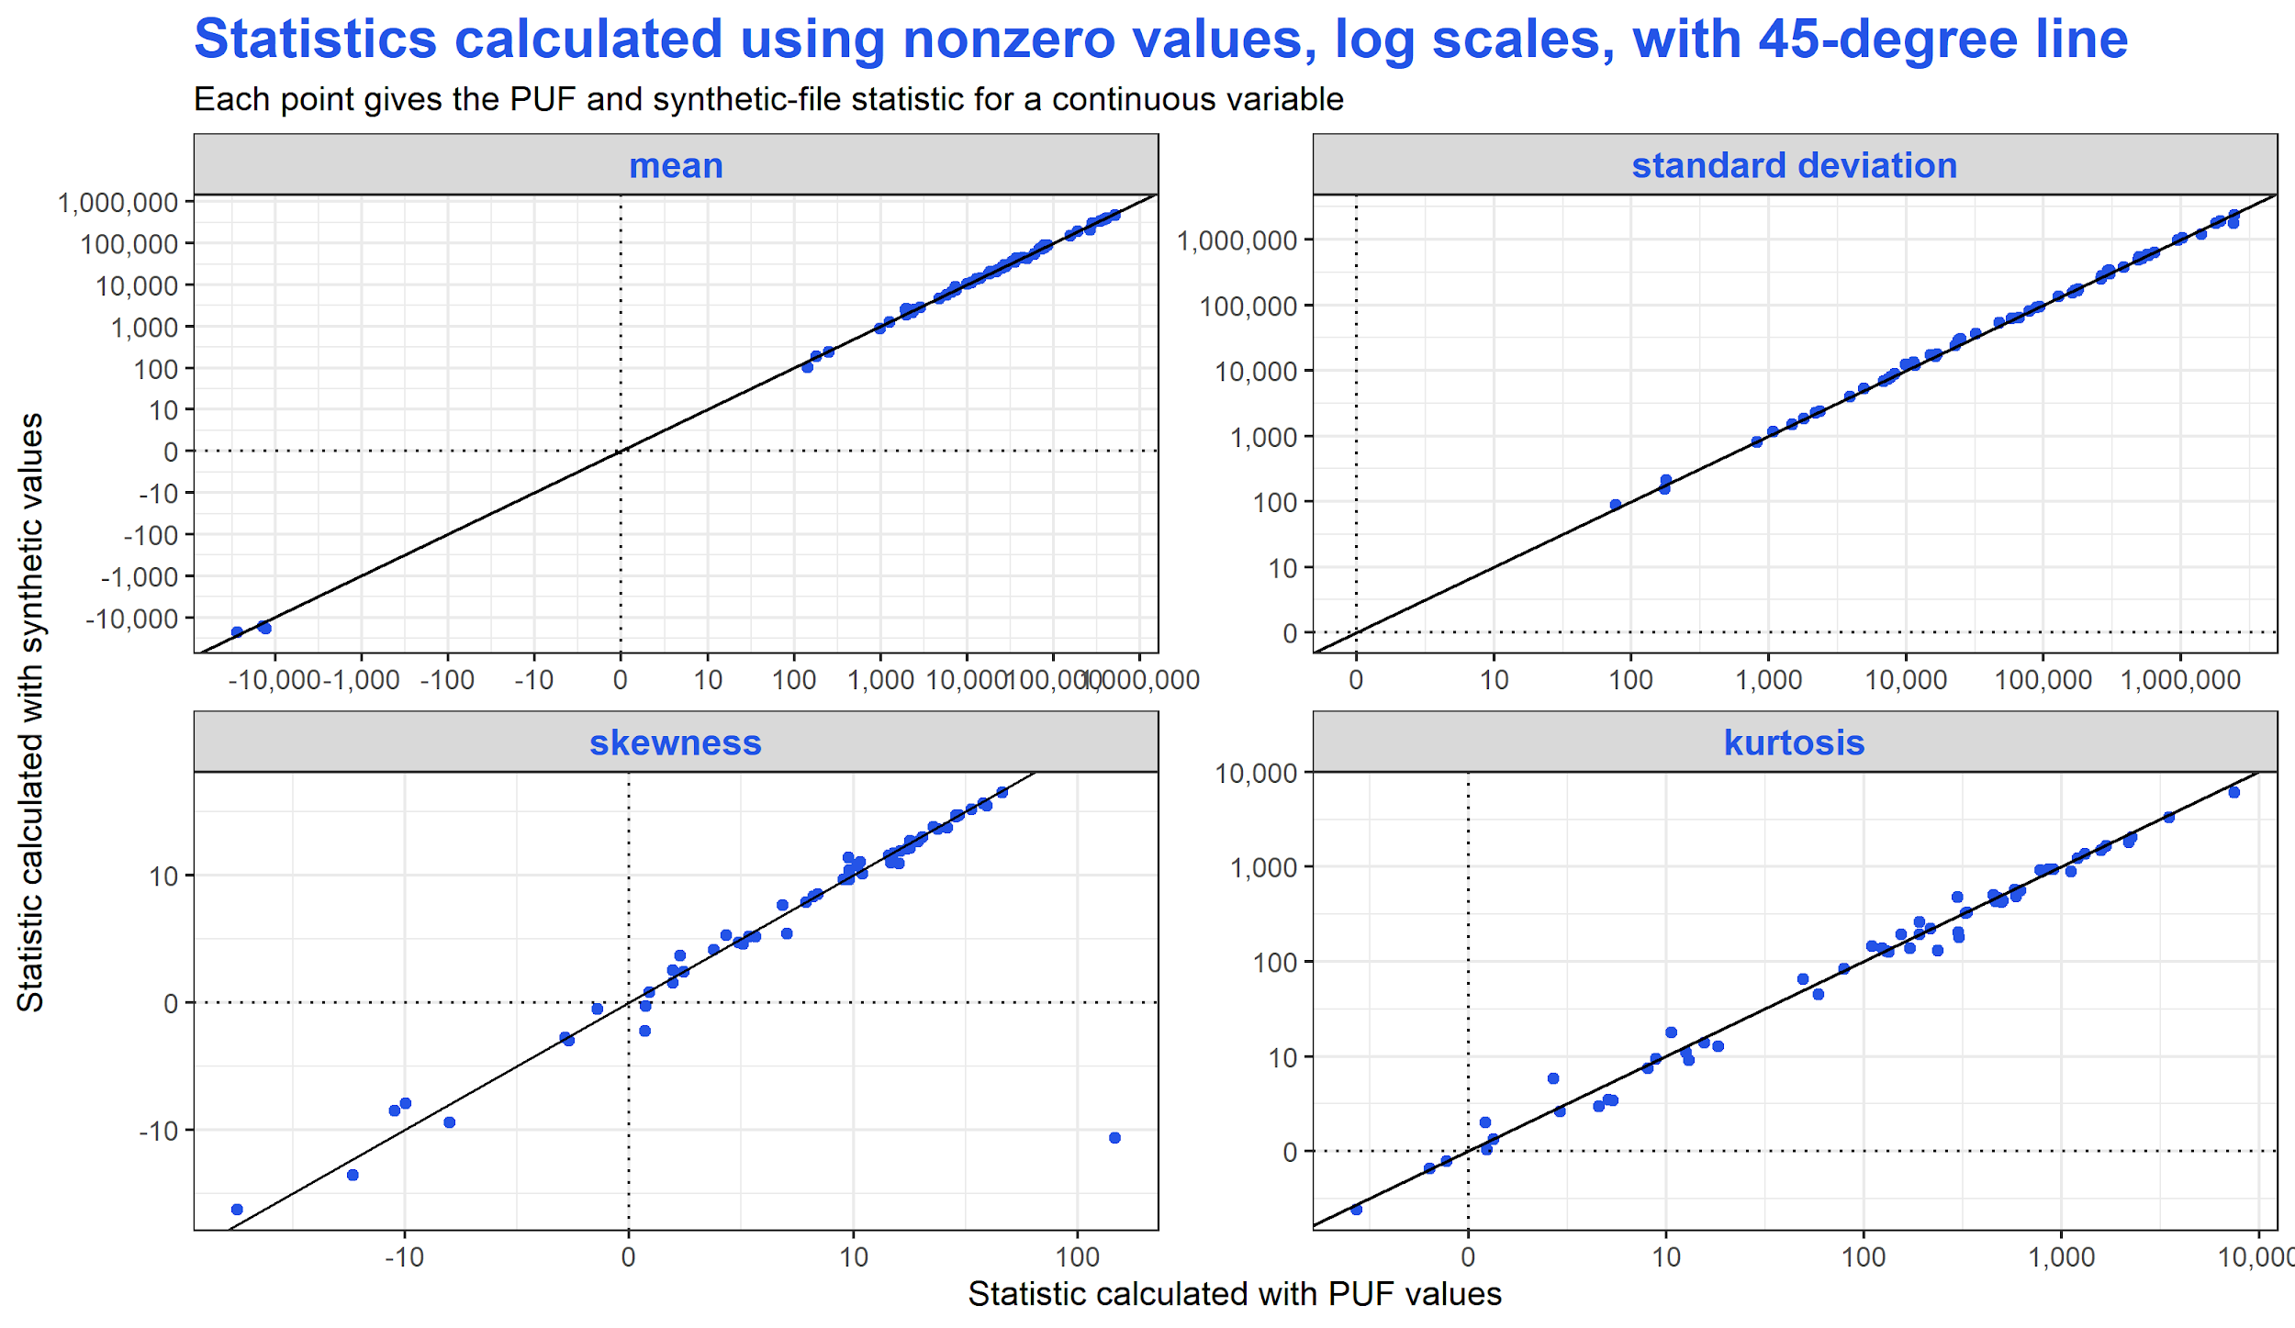
P22250 Short-term gains less losses
Notes:
Skewness: 3rd standardized moment, measure of lopsidedness - positive means hump on the left (remember we use only nonzero values here, also)
Note that we have wrong sign for p22250 - we (the synthetic data) have the hump on the right when puf has hump on the left.
Kurtosis: 4th standardized moment, a measureness of heaviness of tails; here it is relative to the normal distribution, so that positive values mean heavier tails than normal

Slide 25
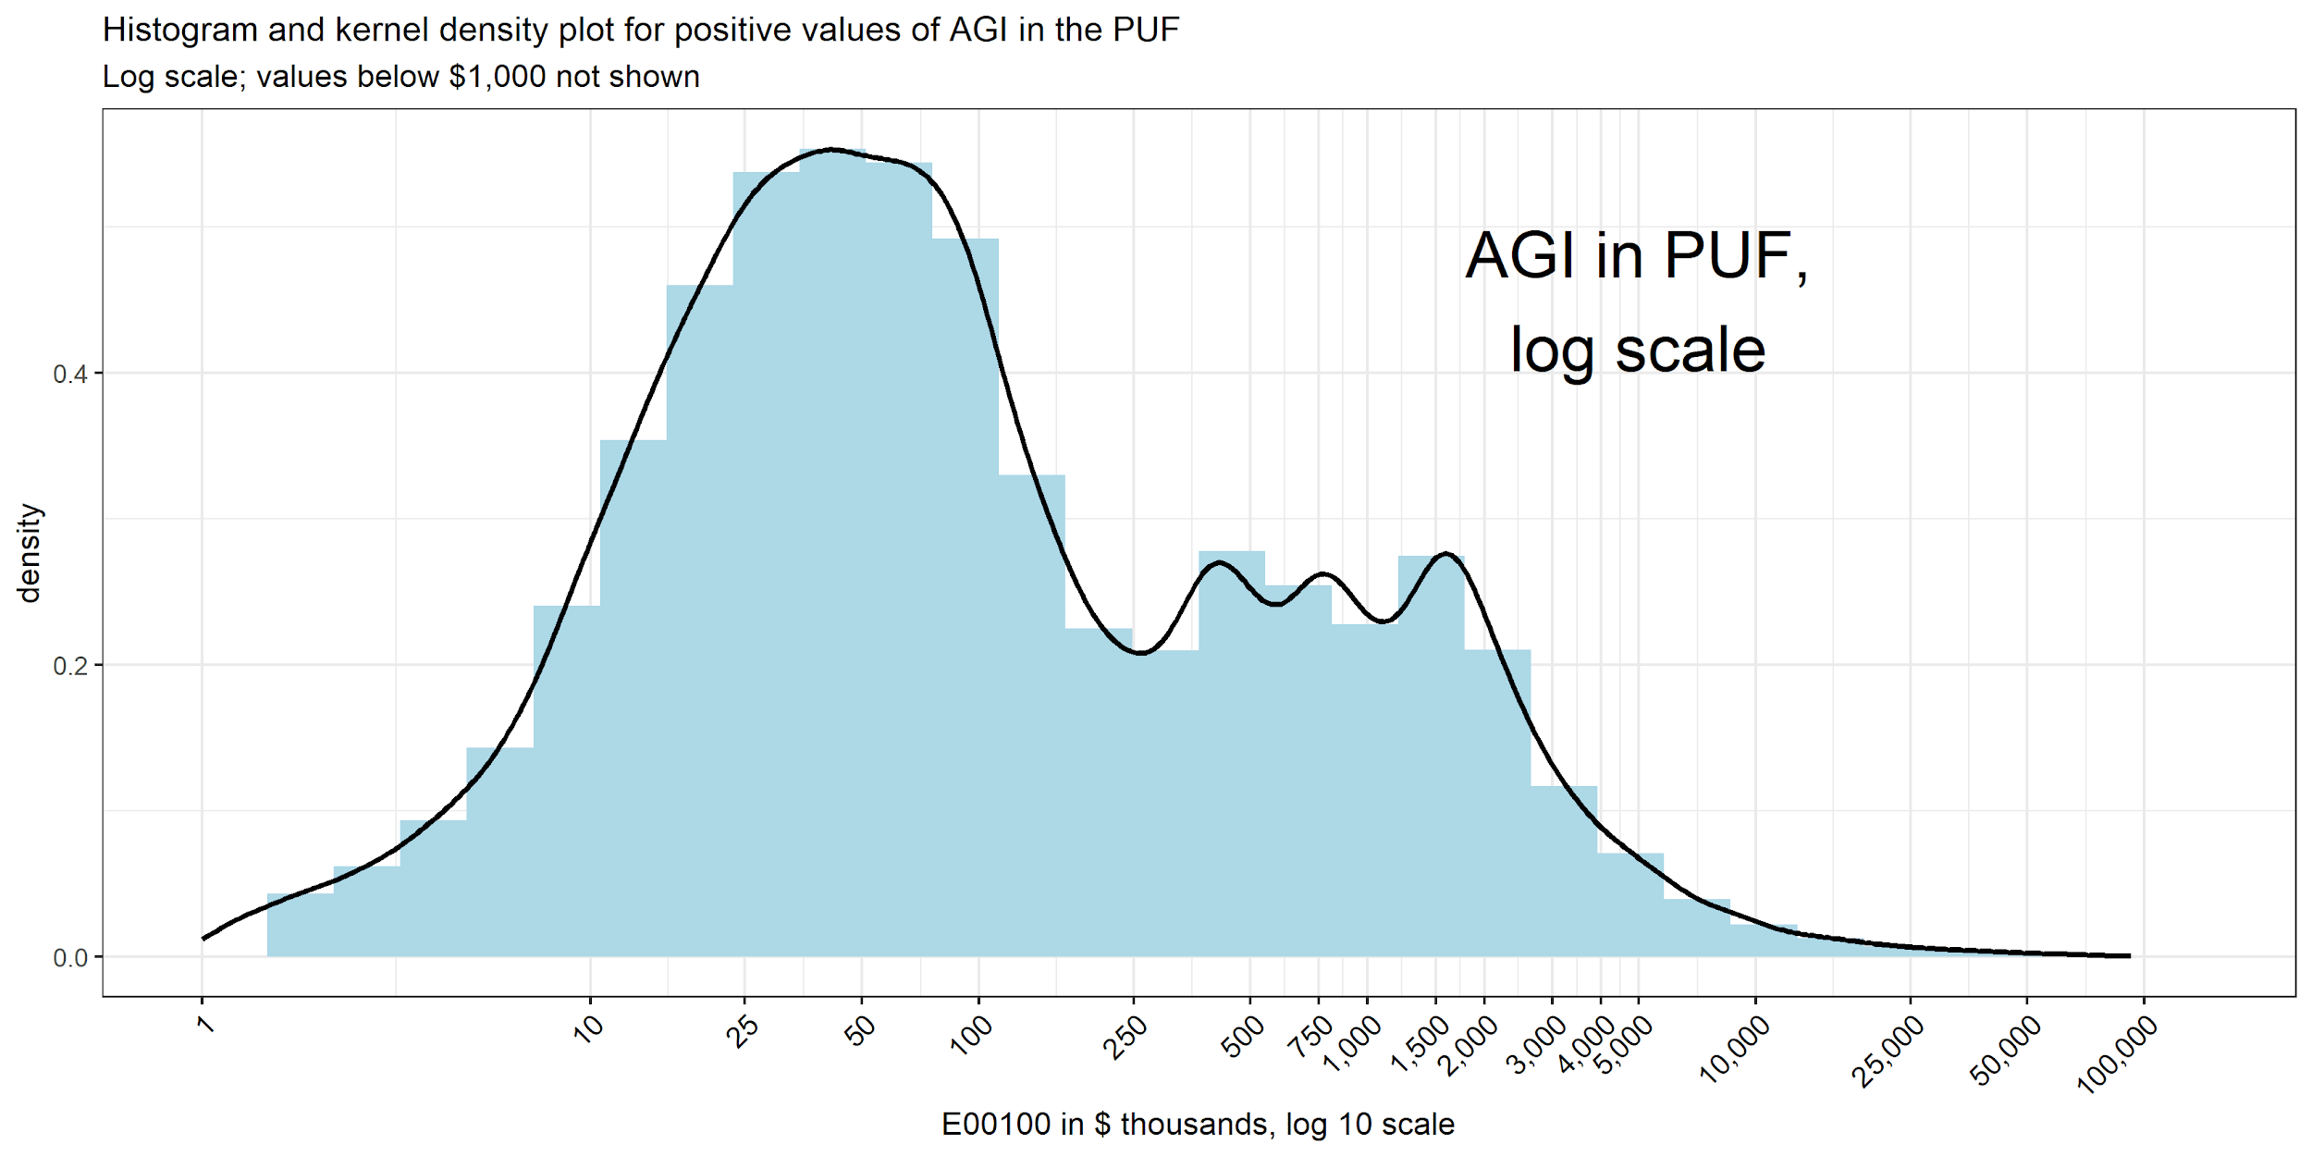
Kernel density plot is like a smoothed histogram. Useful for comparing distributions.

Slide 26
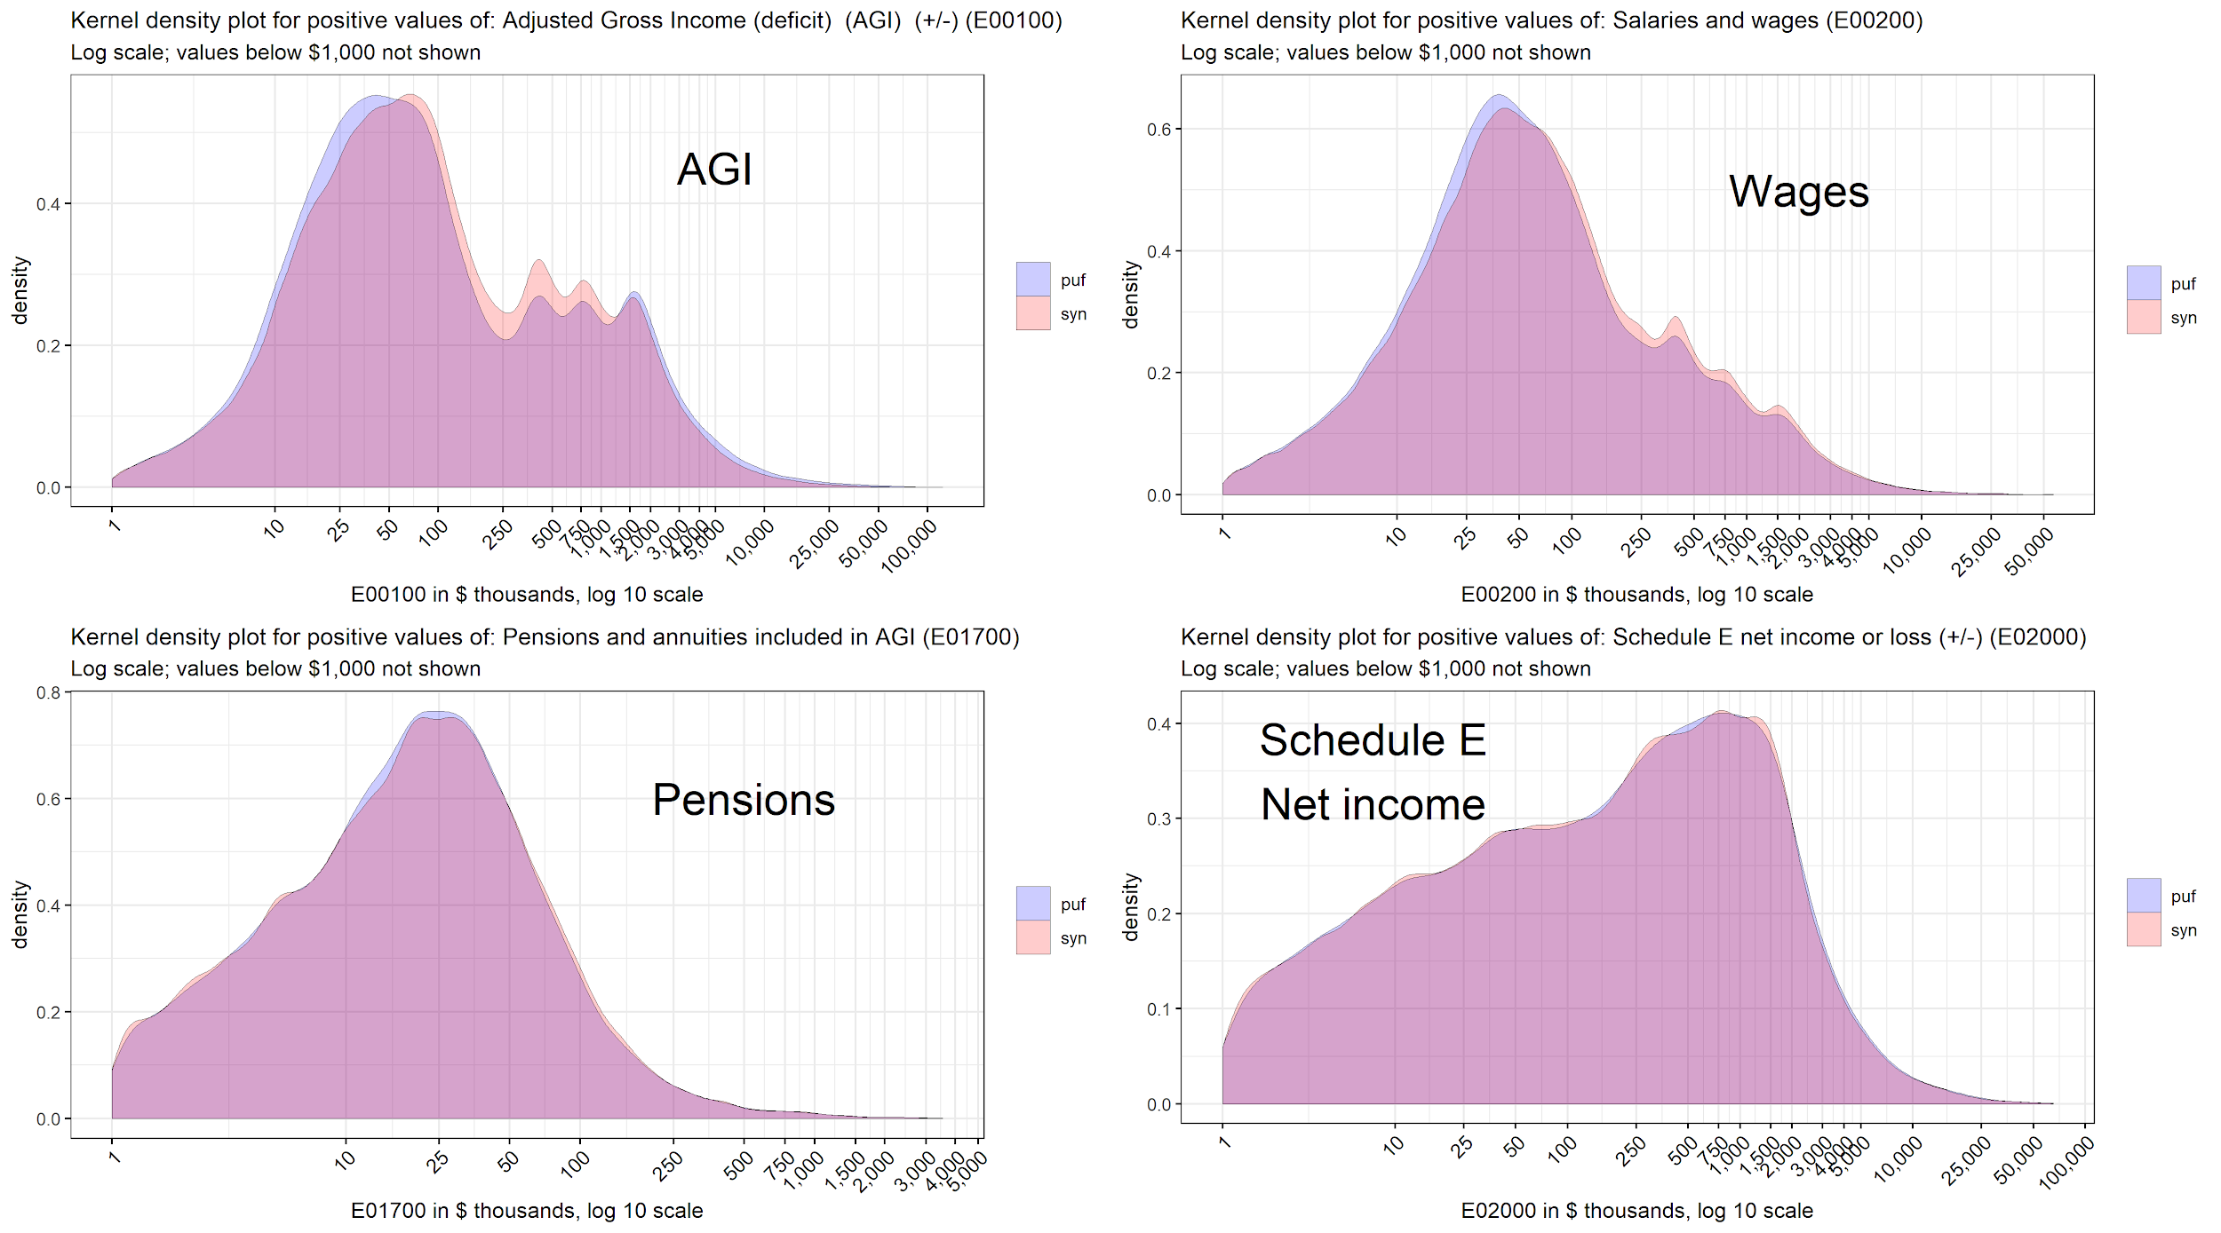
Kernel density plots, 4 large income variables (unweighted)

Slide 27
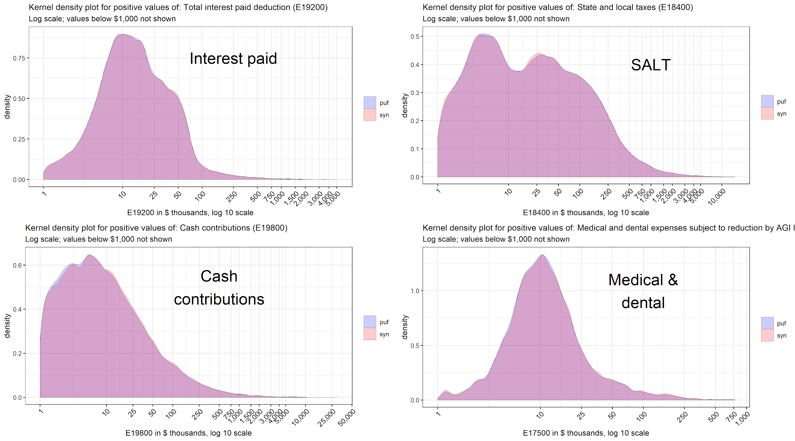
Kernel density plots, 4 large deduction variables (unweighted)

Slide 28
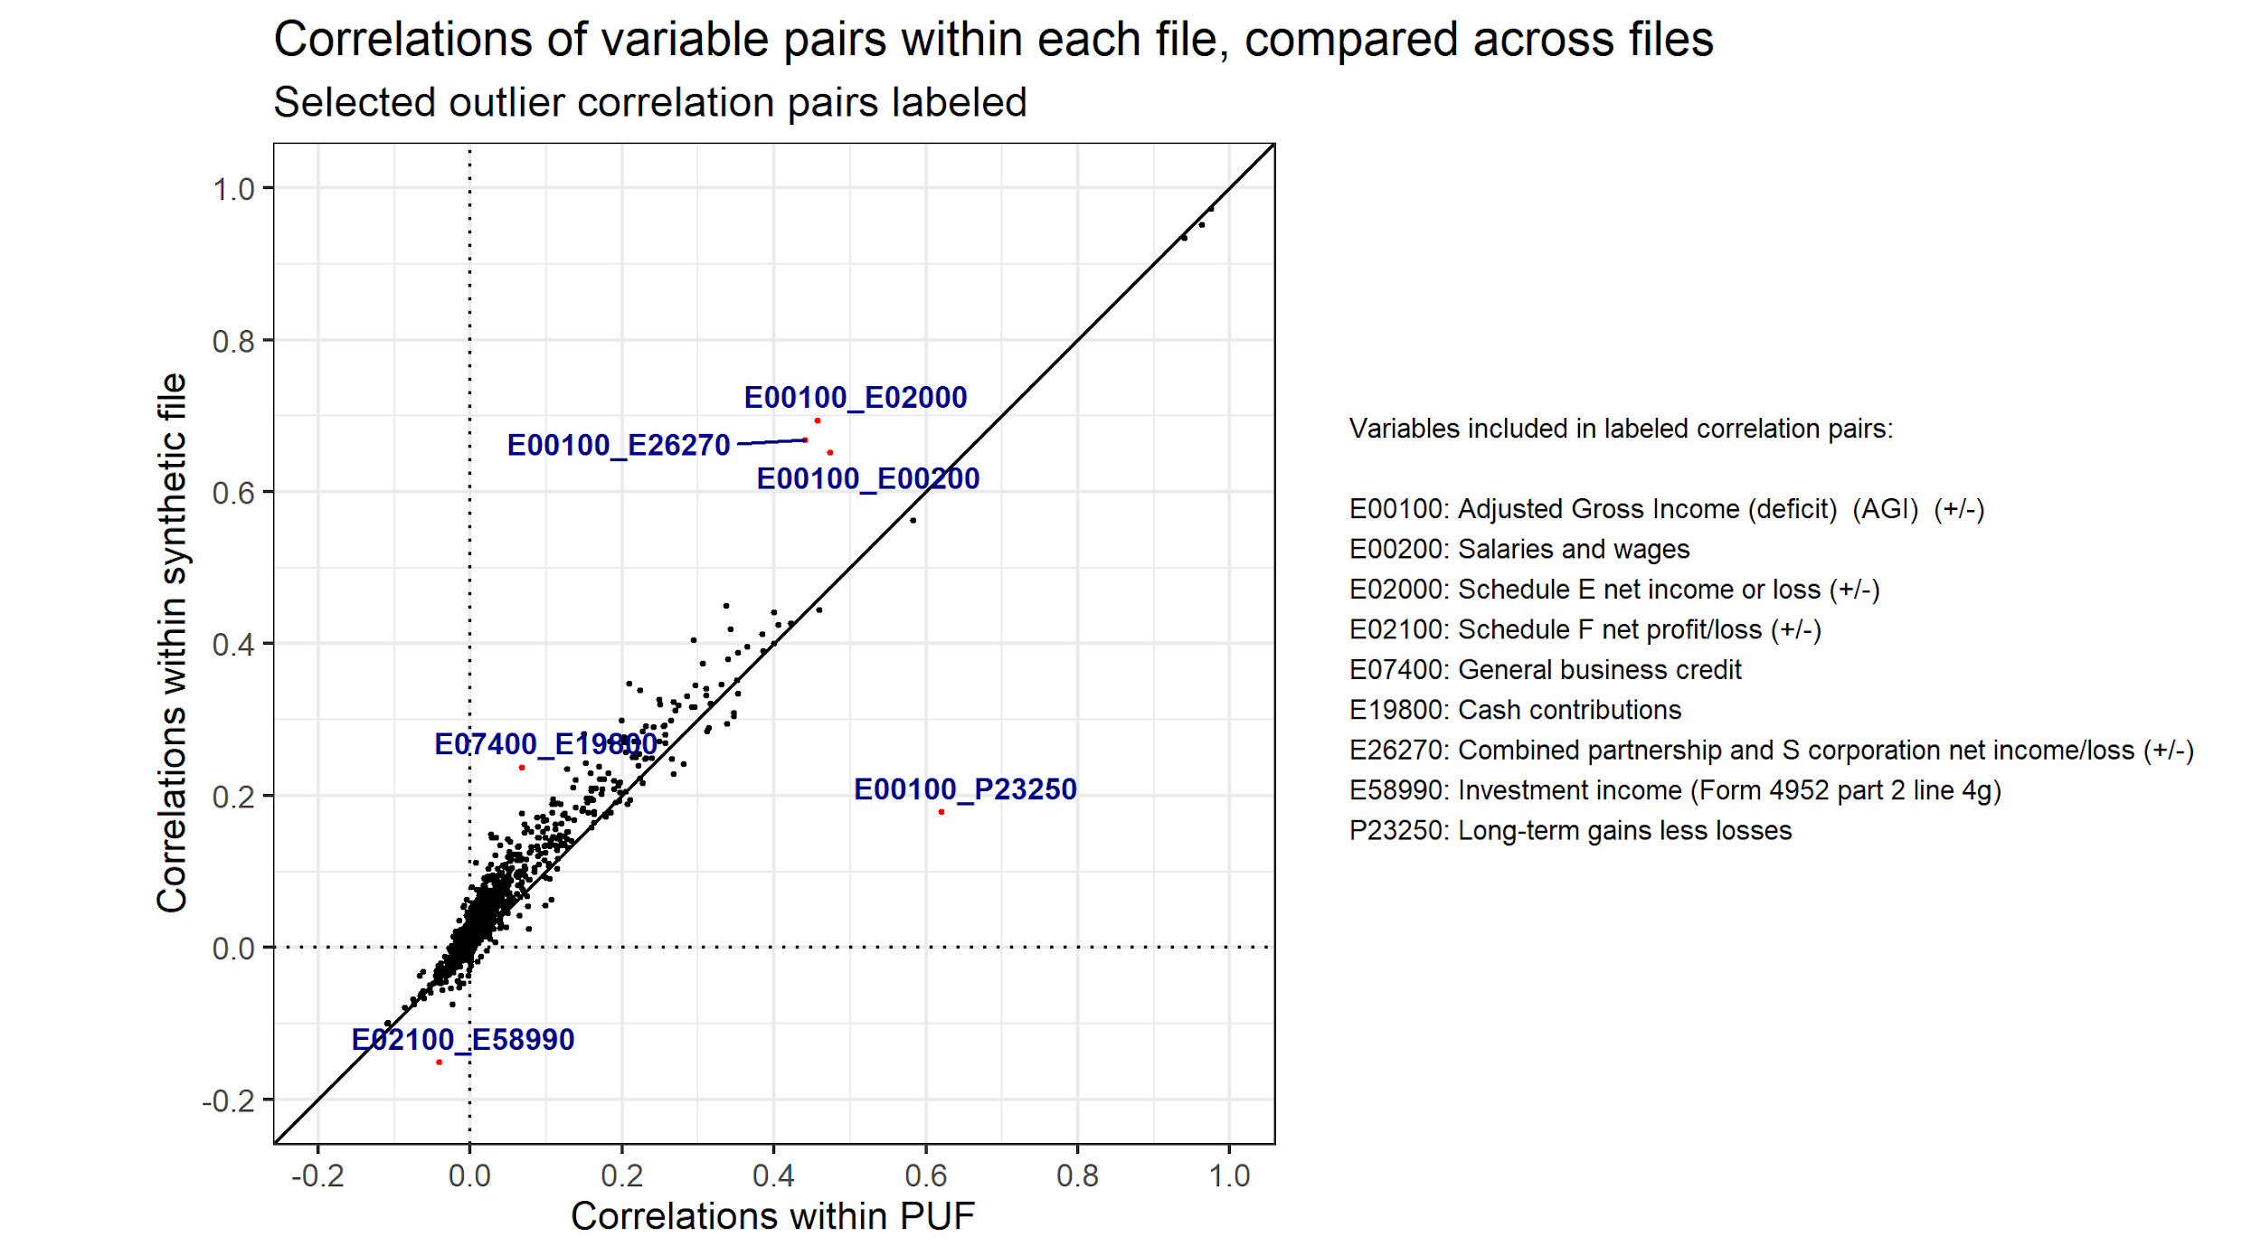

Slide 29
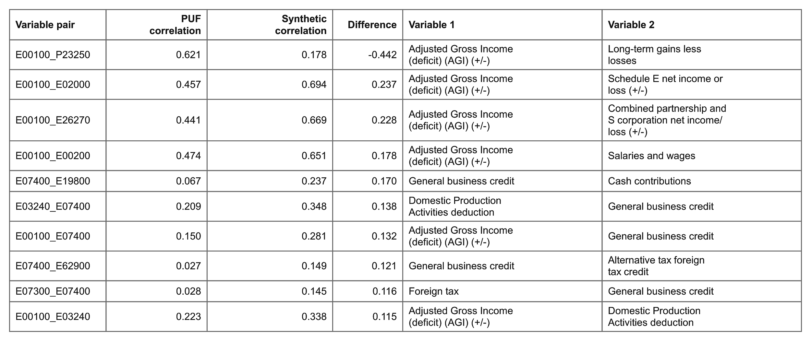
10 worst correlation differences (difference >= ~0.12)

Slide 30
Constructing weights for the file

Slide 31
Approaches considered
Reweighting:
When we created the data, we synthesized (modeled and predicted) record weights based on relationships to other variables
Reweighting starts with these synthesized weights and adjusts:
So that the weighted file hits or comes close to targets based on PUF aggregates,
While penalizing adjustments - the less adjusted, the better
“Weighting from scratch”:
Throw away (ignore) the synthesized weights, and instead...
Choose new weights from whole cloth in a way that minimizes difference between PUF-based targets and weighted file values

Slide 32
Currently we use “weighting from scratch”
Divide PUF into subsets of ~1-2k records based on marital status and AGI -- 124 subsets.
For each subset, for each of ~55 variables, calculate 4 measures: weighted numbers of positive values & negative values, weighted sums of positive & negative values -- i.e., ~220 potential targets.
Remove certain redundant targets. This gives ~128 targets per subset.
Divide synthetic file into subsets using same cutpoints (~5-10k records each).
For each subset, choose weights for each record that minimize a priority-weighted sum of squared differences between actual PUF targets and computed synthetic sums (using the chosen weights).
Highest priority in the sum of squared differences is given to AGI and a few other critical variables. This is based on judgment.

Slide 33
Simplified example for one file subset
Let’s say PUF file subset # 17 (out of 124 subsets) has 1k married-joint PUF records with AGI in the $10-20k range and:
Total AGI of $580 million
Total negative capital gains of -$50 million
...and 126 other targets
We want AGI target to be 20x as important as capital gains target
Corresponding synthetic subset has 5k married-joint records with $10-20k AGI. We choose 5k weights ws[i] that minimize the penalty function:
20 * {sum(ws[i] * agi[i]) - 580}^2
1 * {sum(ws[i] * (capgains[i] if negative)) - -50}^2
priority-weighted squared differences from ~126 additional targets
Note: We also do some scaling, not shown here.

Slide 34
Solving the weighting problem
We have:
124 file subsets
~5-10k synthetic records per subset, choose weight for each record
~128 targets per subset
Thus we have ~16k targets (124 x 128) for the entire synthetic file
File subsets are mutually exclusive and can be solved in parallel
Penalty function is nonlinear. No constraints (they are built into objective function). Bounds on the weights (e.g., >=1).
Currently we solve with MMA (method of moving asymptotes)
Solves in about an hour, in parallel (6 cores), with 500 iteration limit
Generally suboptimal but very good solutions; could run longer

Slide 35
Enhancing the file via TaxData

Slide 36
TaxData enhancement - major elements
Brings in selected information and relationships from the CPS ASEC, and prepares the file for Tax-Calculator:
Create tax units from the CPS file
Match tax units between the CPS and IRS-SOI
Split certain income items between prime and spouse
Add non-filers from the CPS to the matched file
Develop factors needed to extrapolate data to future years:
Growth factors for wages, dividends, and other variables
New weights that allow the file to hit targets for future years
Ratios to adjust distribution of certain interest income

Slide 37
So far we have succeeded in applying some but not all TaxData enhancements
Harder than I expected
Several small issues have taken time to identify and resolve.
Extrapolating to future years with 5x as many records requires careful examination and review to ensure good results.
Issues are resolvable; our next synthesis will nip some in the bud.

Slide 38
Comparing enhanced synthetic & PUF files
Currently, our best comparative file:
Has the CPS additions
With a few small workarounds, mostly relating to prime-spouse splits of Schedule E and F income.
Extrapolated to the first tax year in Tax-Calculator: 2013.
We construct an enhanced PUF that has the same CPS additions and workarounds, also extrapolated to 2013.
This allows tax-analysis comparison of:
apples that are slightly bruised (synthetic)
to
apples intentionally bruised in the same way (PUF)

Slide 39
Evaluating the weighted & enhanced synthetic file: Tax analysis

Slide 40
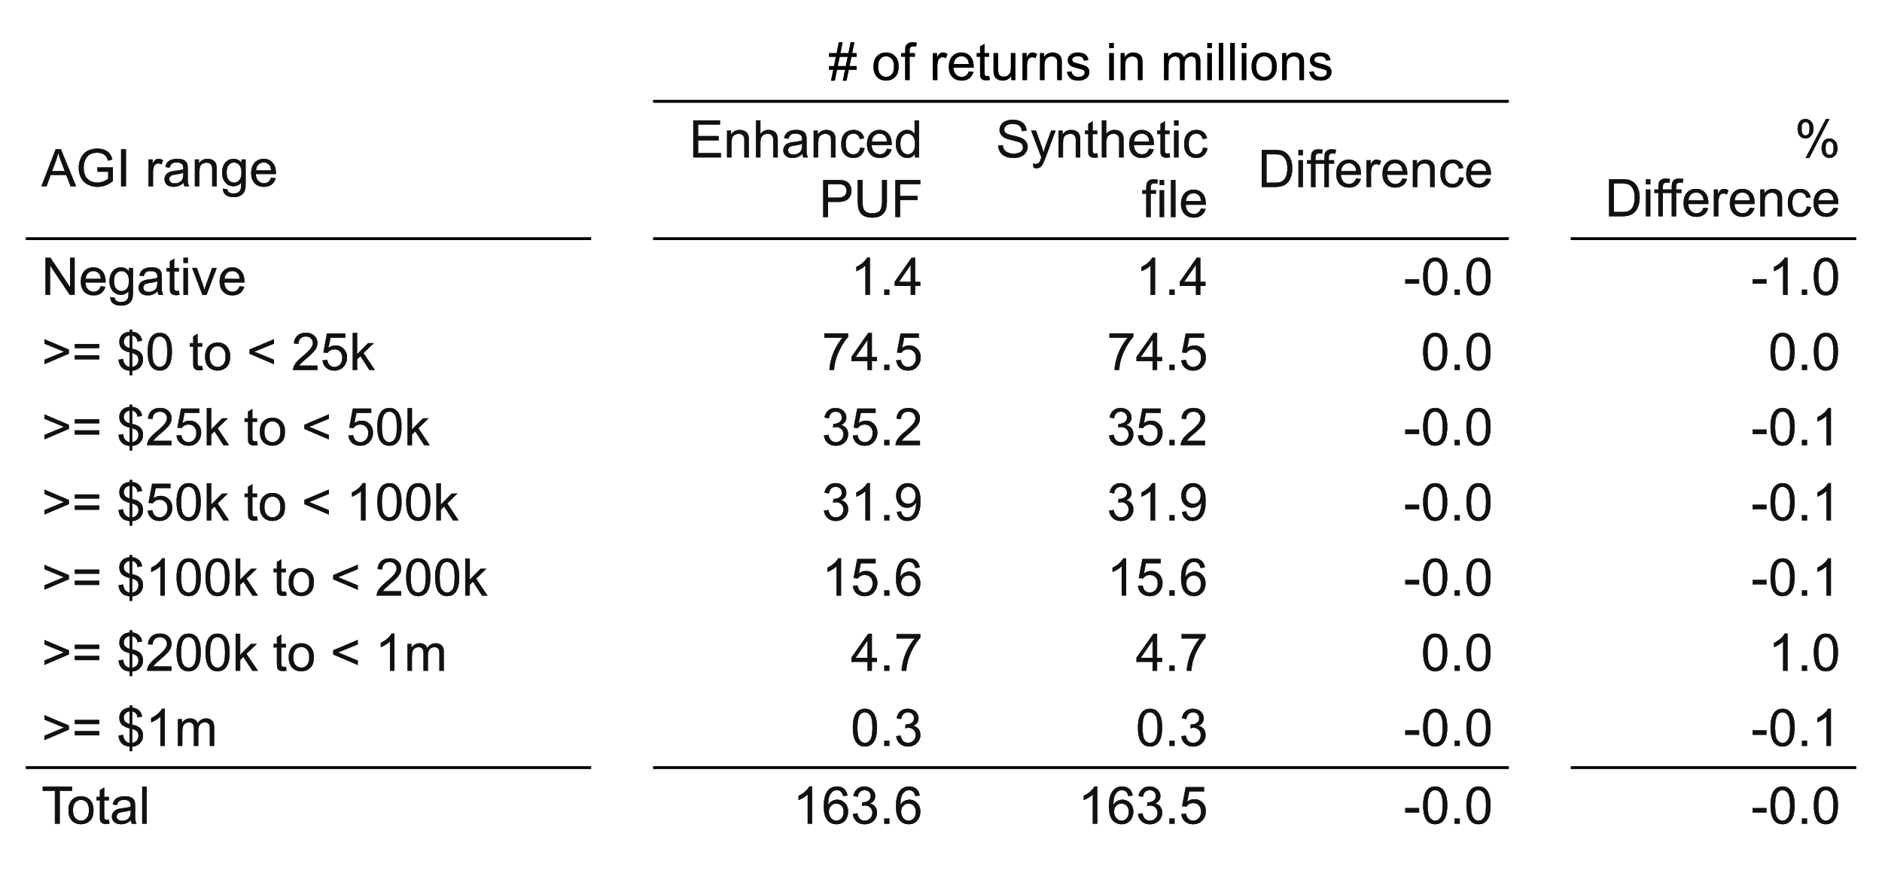
Number of returns (2017 tax law, 2013 income)
Enhanced synthetic file and enhanced PUF, comparability-adjusted

Slide 41
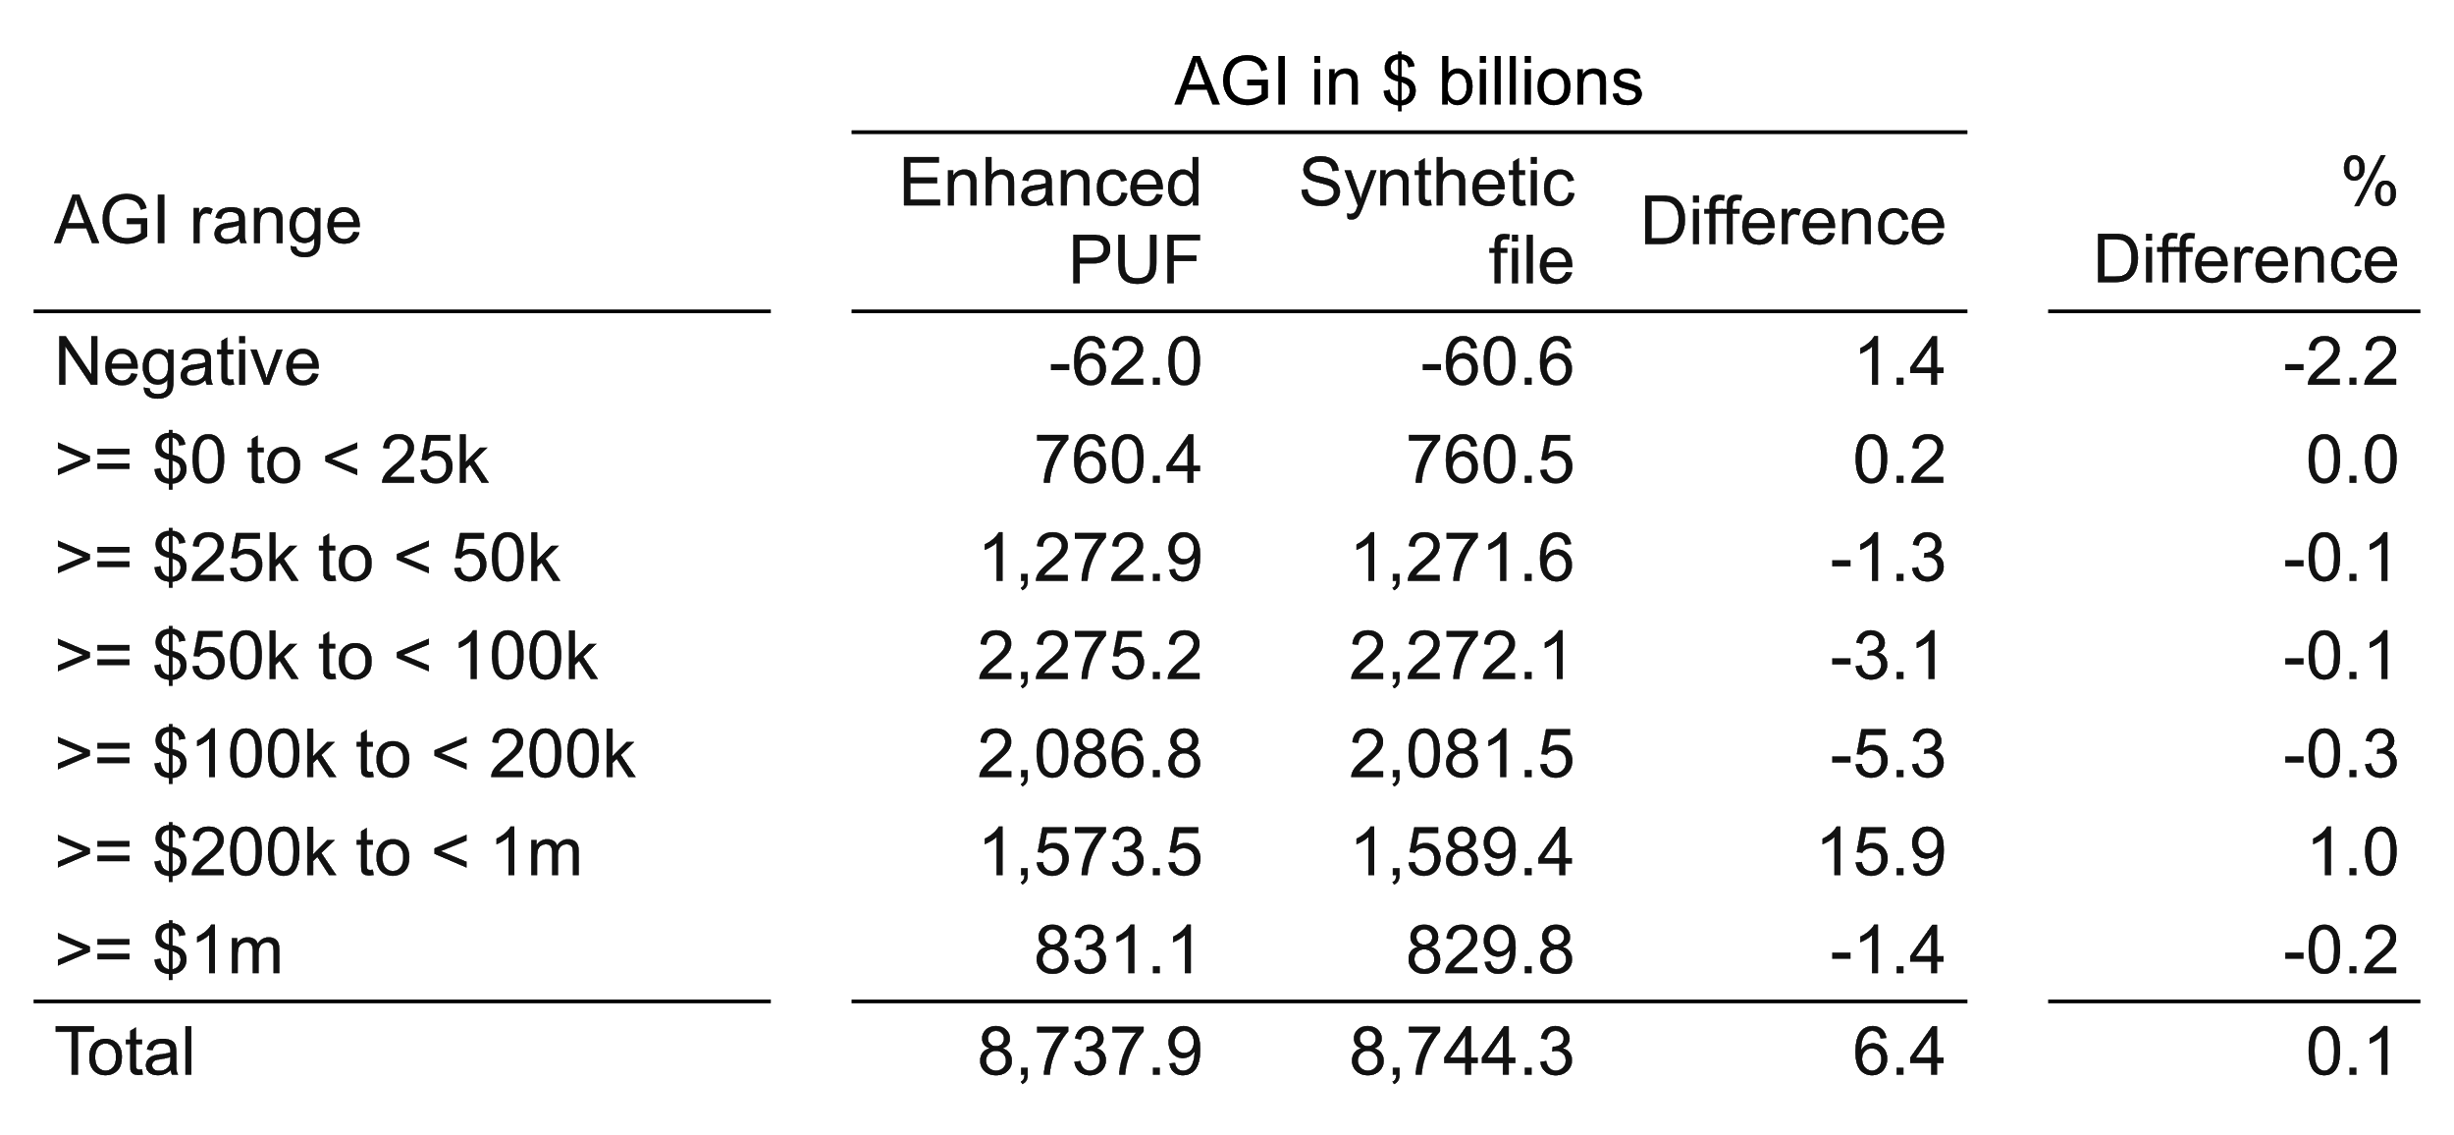
Adjusted gross income (2017 tax law, 2013 income)
Enhanced synthetic file and enhanced PUF, comparability-adjusted

Slide 42
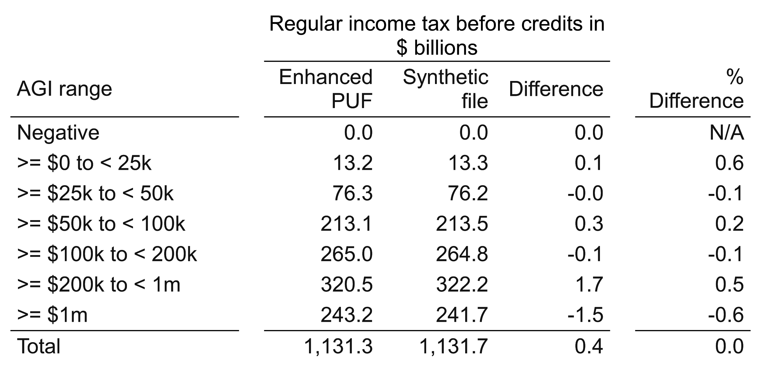
Regular tax before credits (2017 tax law, 2013 income)
Enhanced synthetic file and enhanced PUF, comparability-adjusted
This will come back to haunt us.

Slide 43
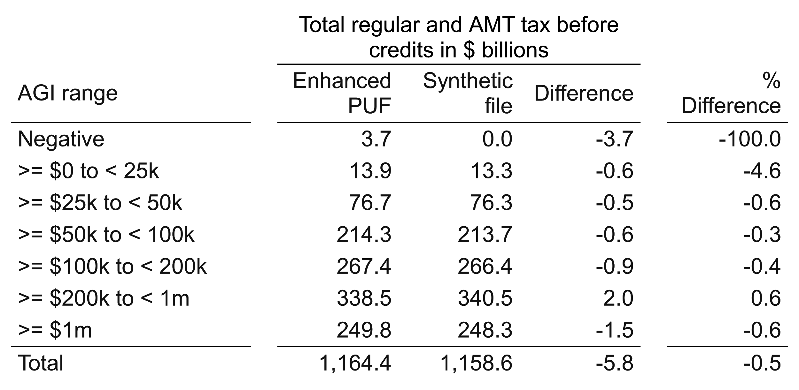
Total regular tax + AMT (2017 tax law, 2013 income)
Enhanced synthetic file and enhanced PUF, comparability-adjusted

Slide 44
Lessons from our baseline analysis
Enhanced synthetic file is close to enhanced PUF on many aggregates.
Further off than I would like in upper-income ranges
We are far off on AMT and thus further than we would like on total income tax liability (regular + AMT).
We know some reasons for differences. I believe the problems generally will be solvable.
Some of the solution will come from better weighting.
Some may come from better synthesis.
It is a lot of work to track the reasons down and then solve the issues. But it is hard work, not impossible work.

Slide 45
Now we examine two tax reforms, vs. 2017 law
Simple across-the board rate cuts
A complex reform with winners and losers
Eliminate all standard and itemized deductions
Decrease regular income tax rates
Increase capital gains rates and pass-through-income rates
For the complex reform, we drill down into winners and losers, including by marital status.

Slide 46
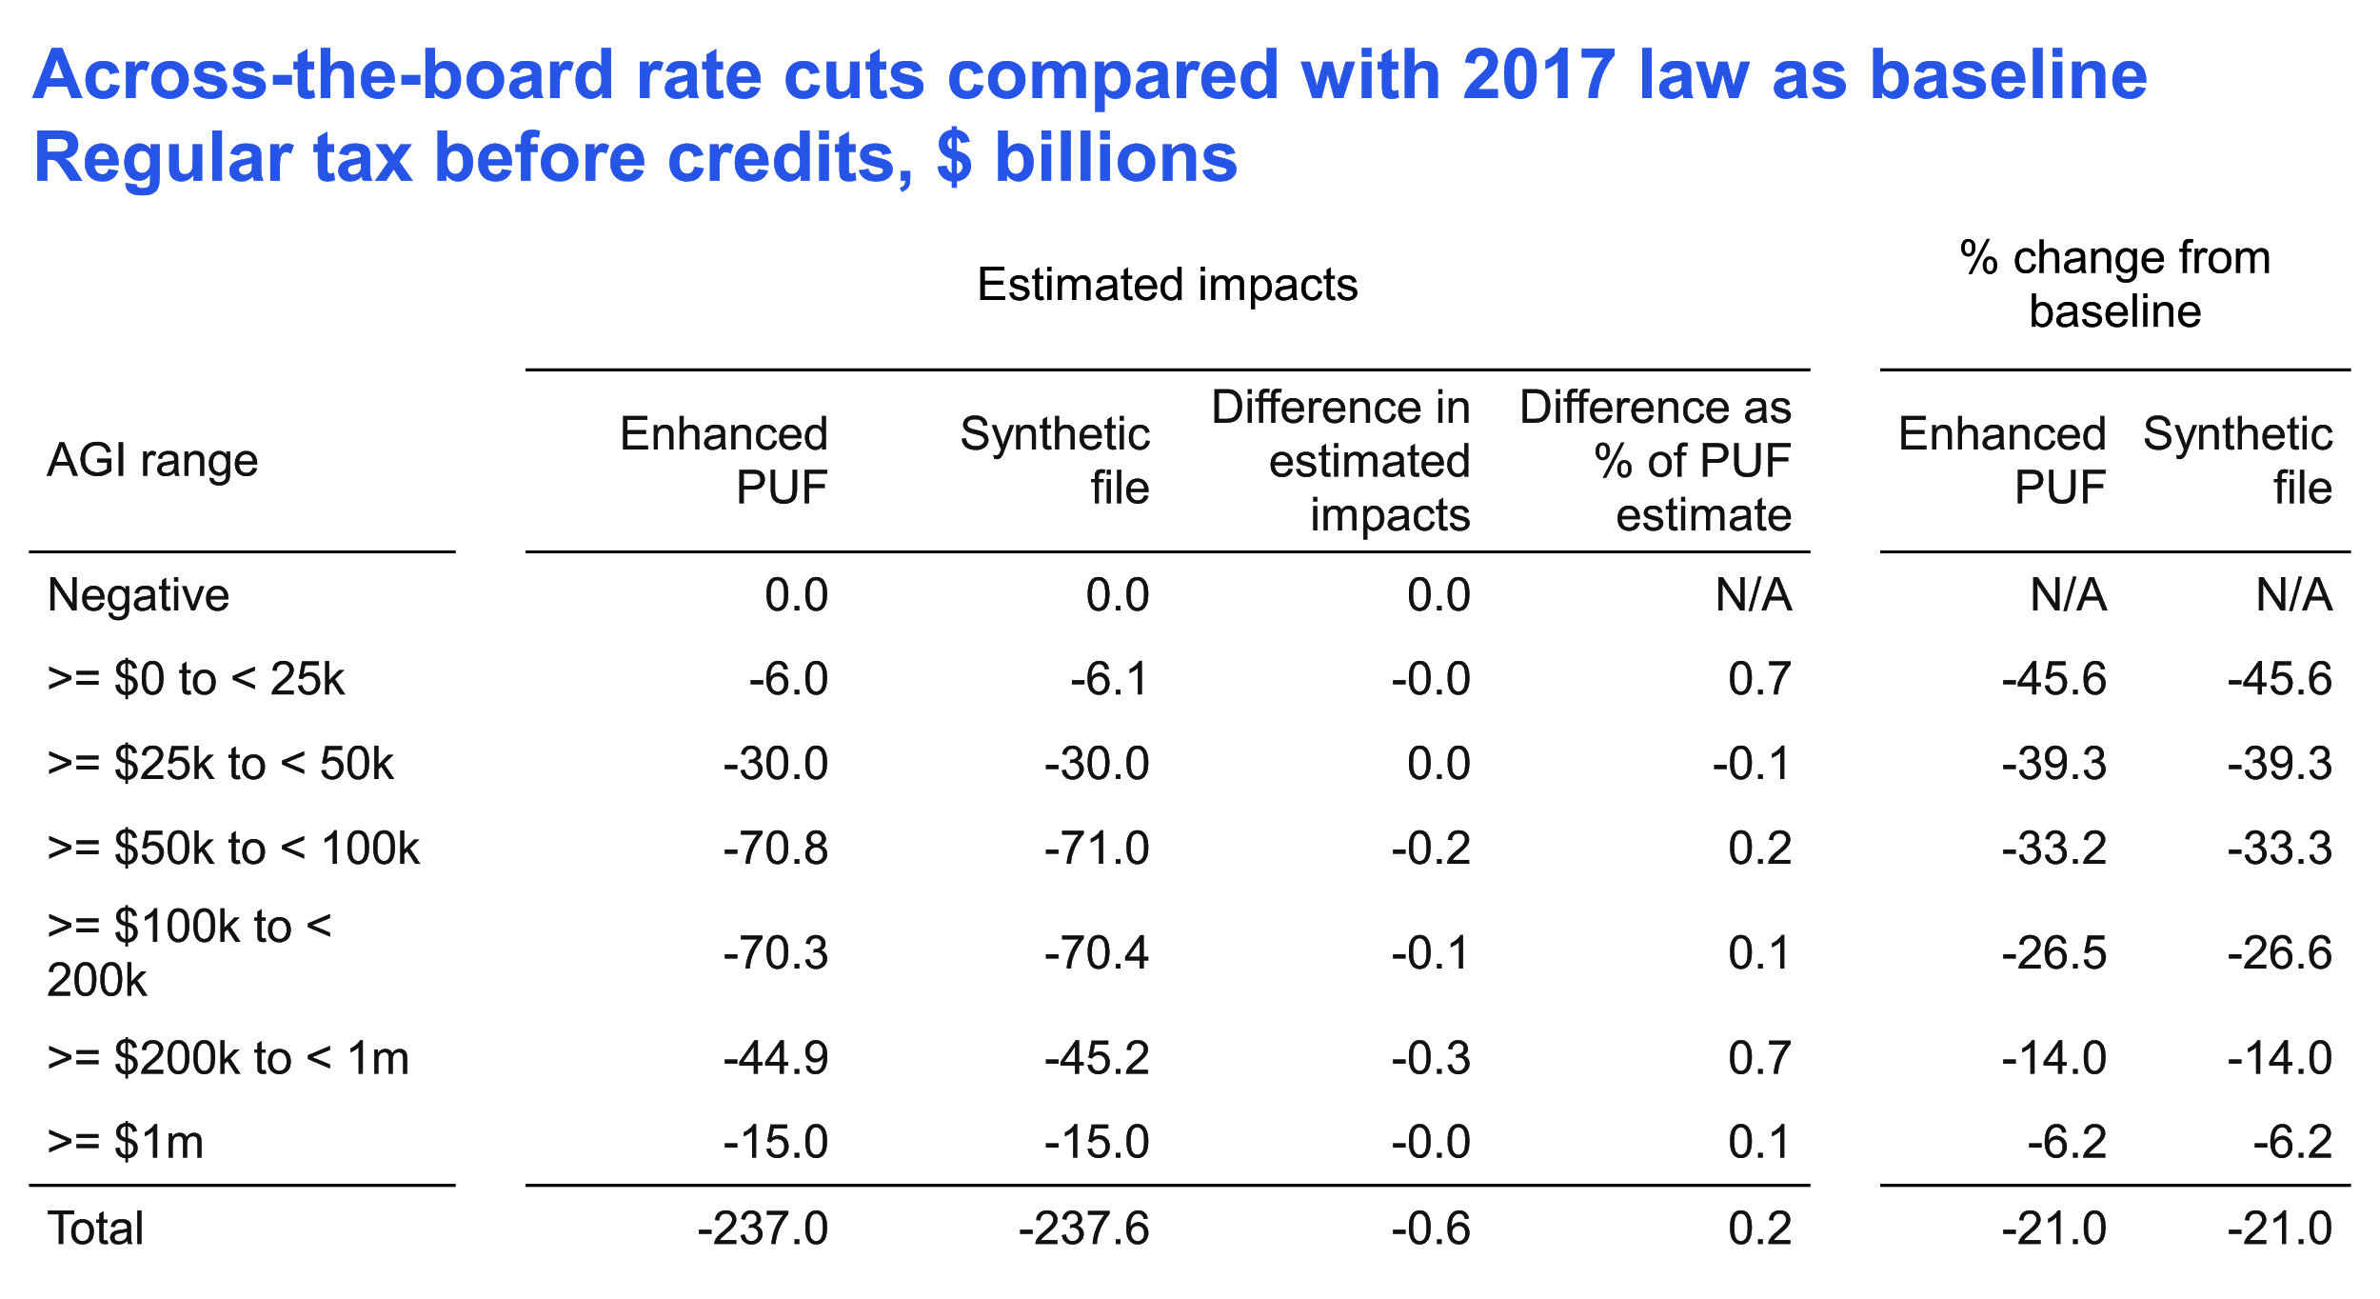

Slide 47
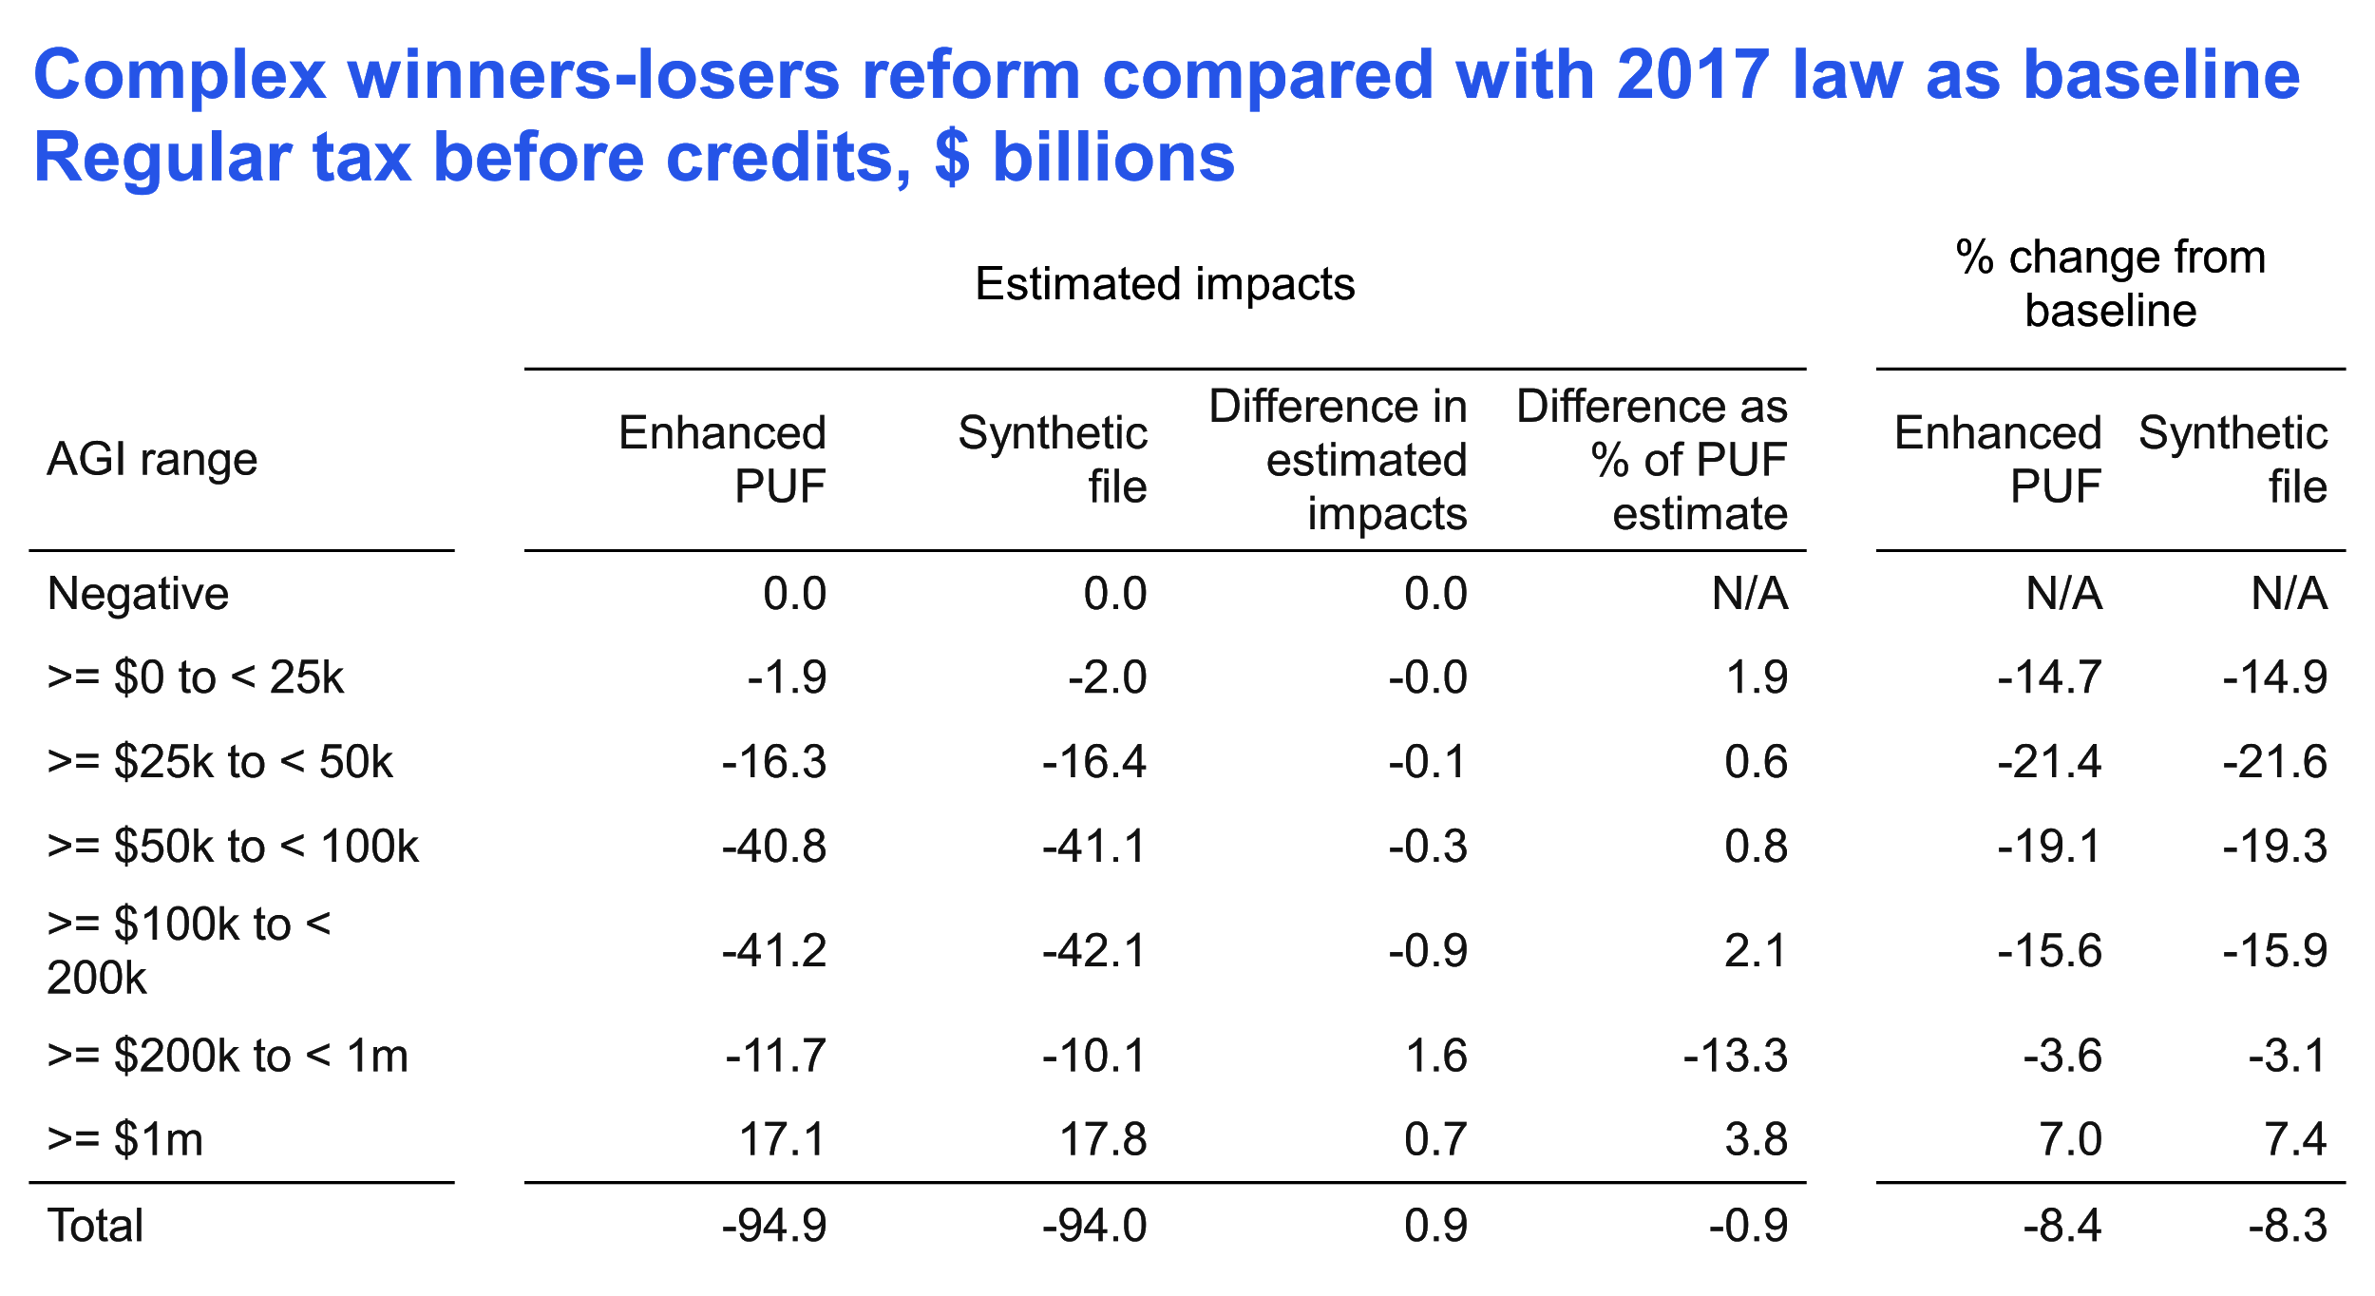

Slide 48
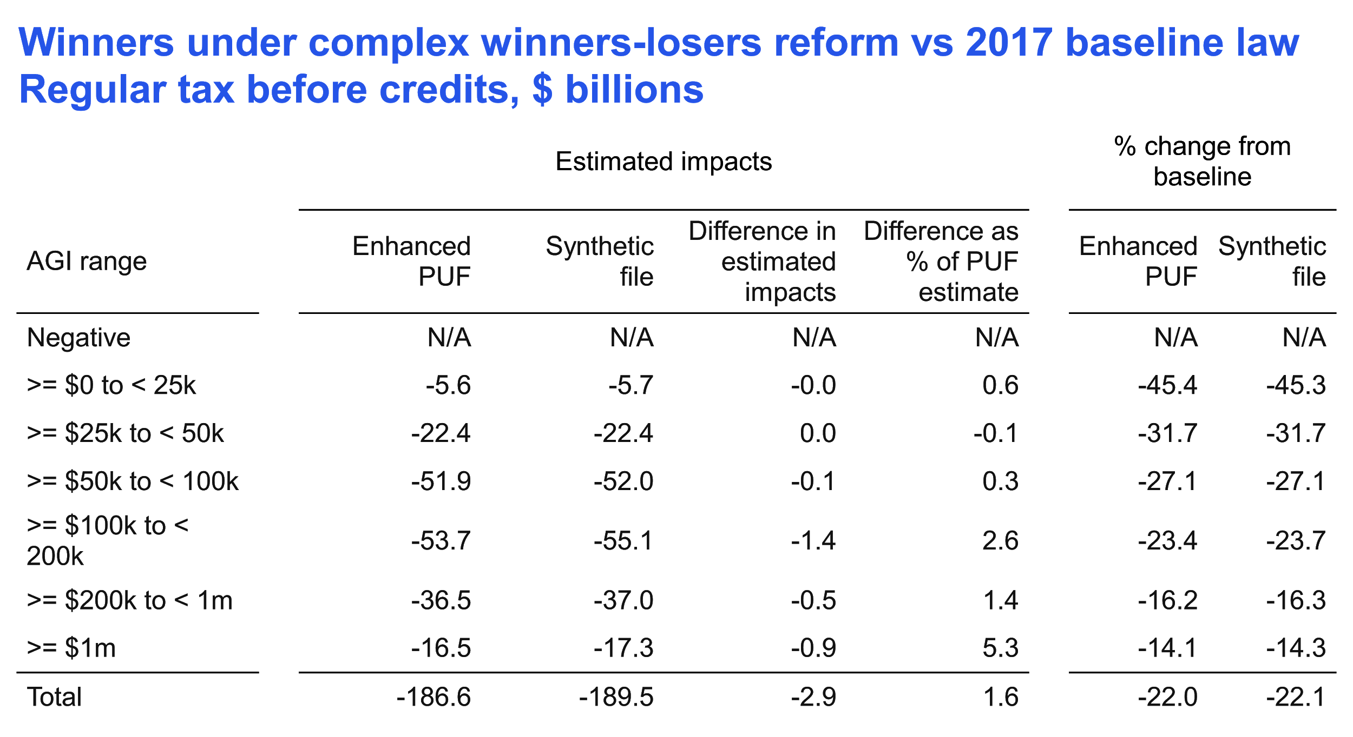

Slide 49
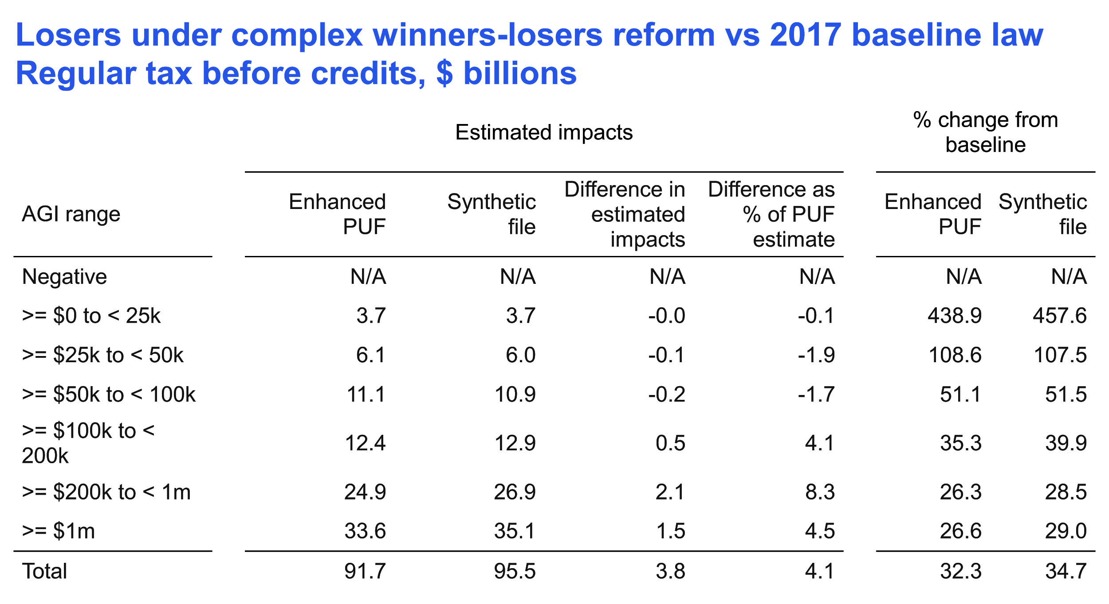

Slide 50
Drill down further and look at single filers who are winners

Slide 51
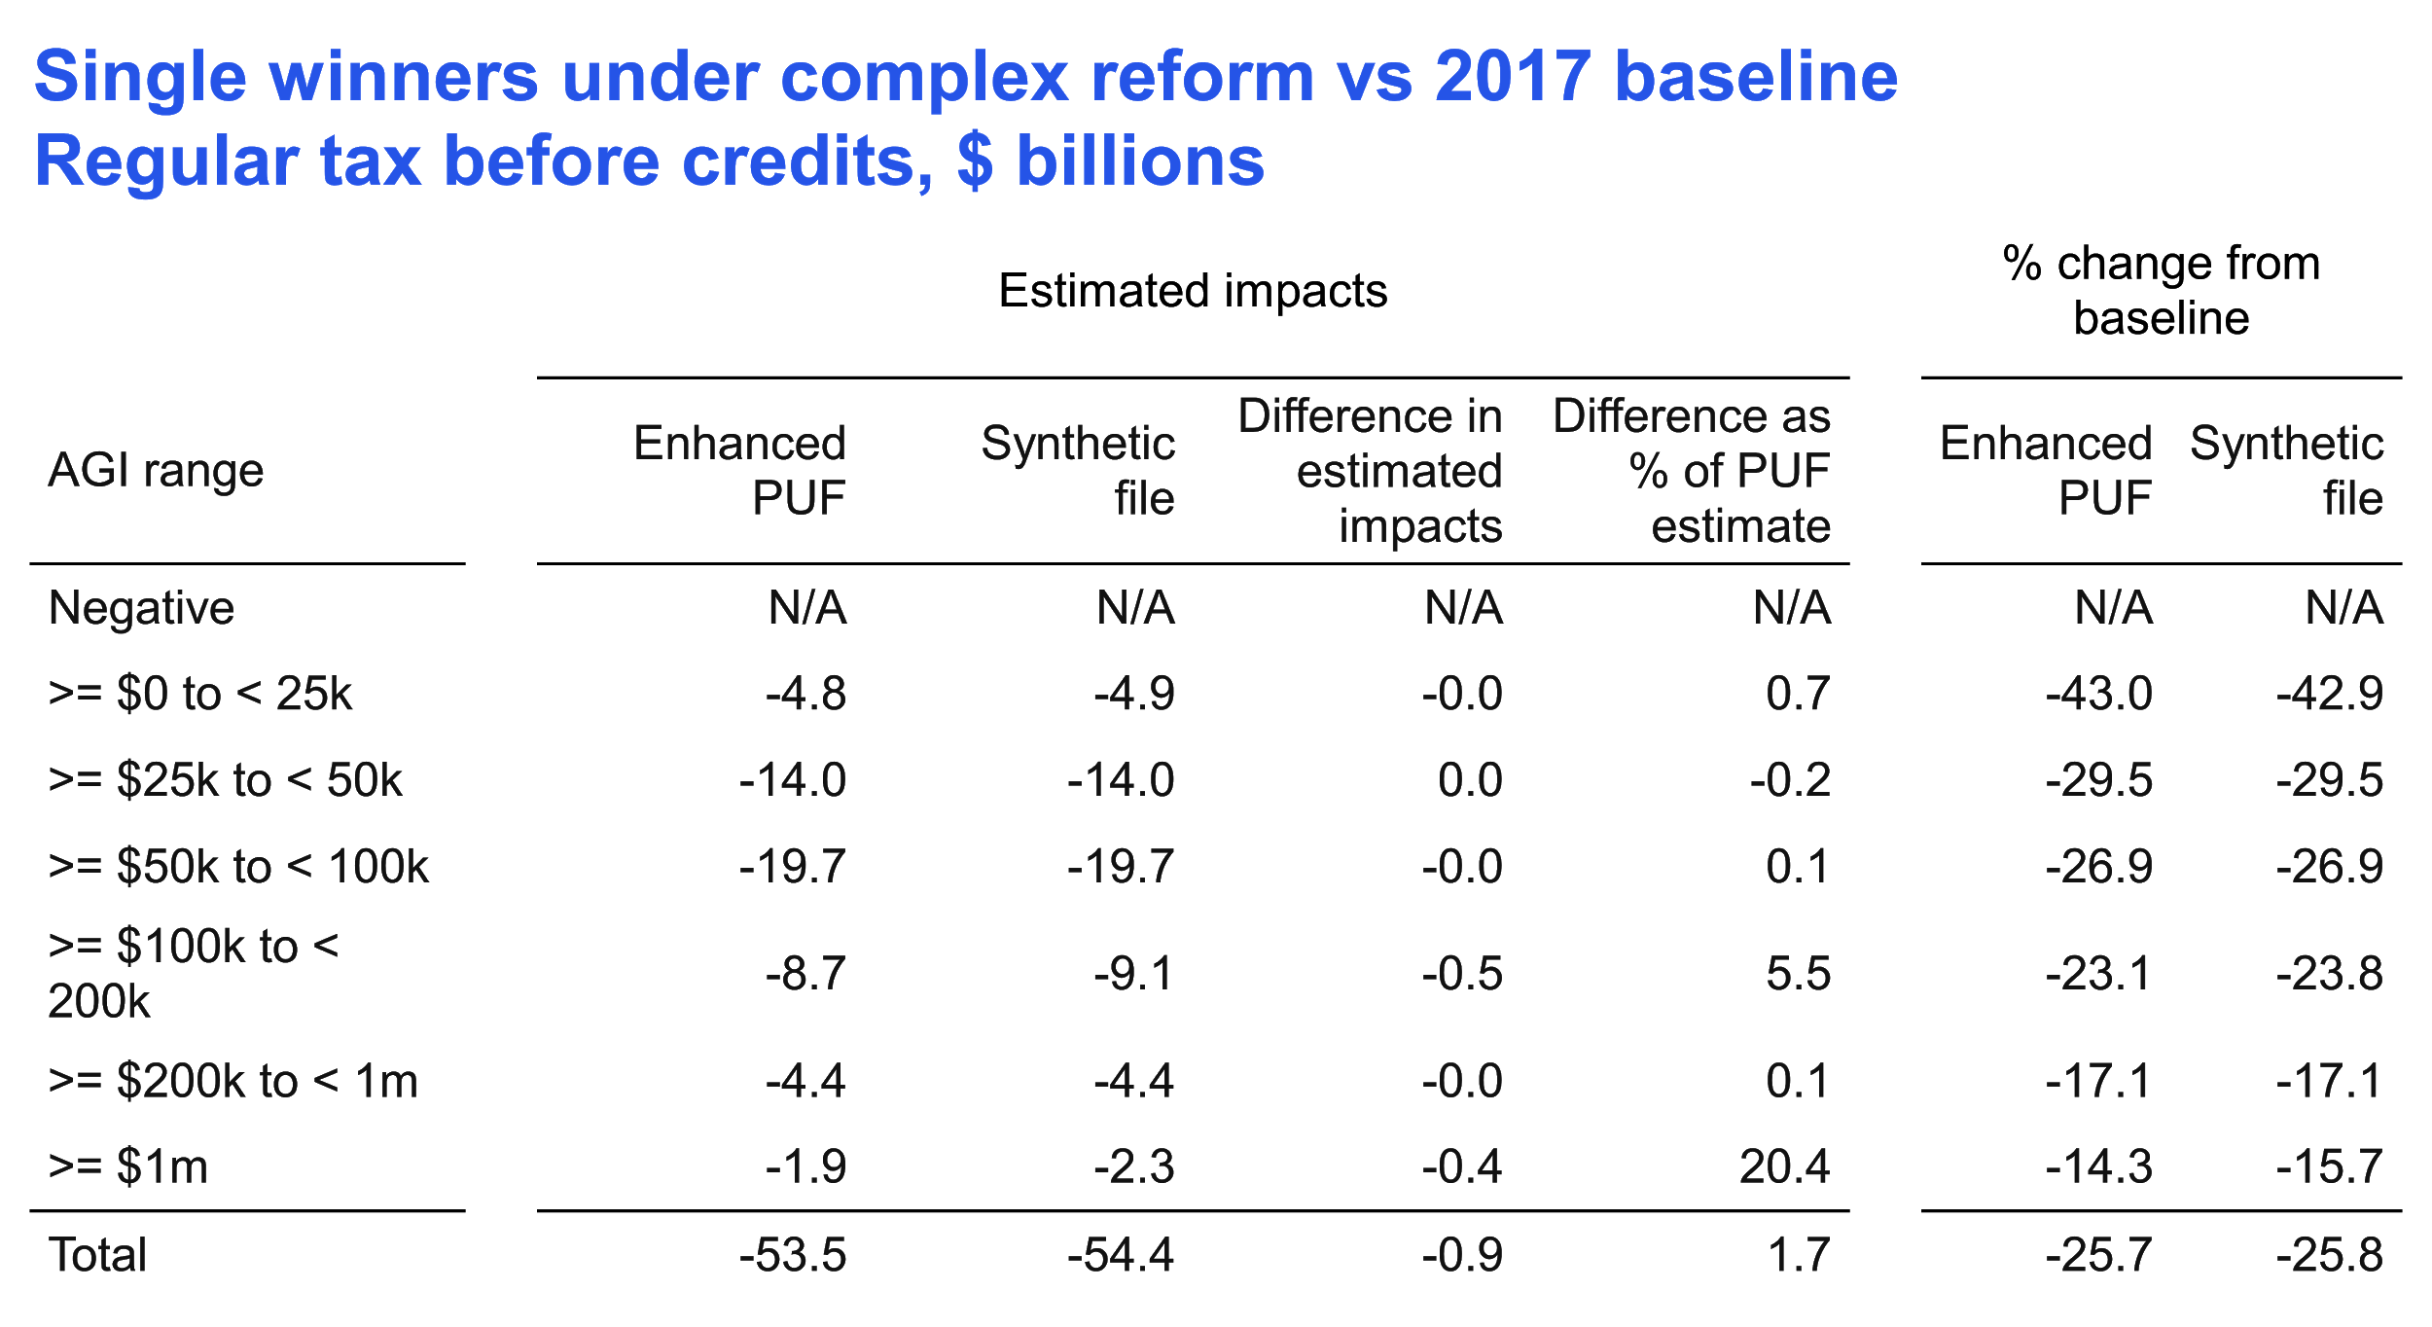
How much do these bother us (for a first effort)?

Slide 52
Lessons from these tax-reform analyses
Simple rate cut: Did very well. Easy: we just have to get weighted distribution of AGI and taxable income right, not income components.
Complex reform:
In aggregate - did well
Top 2 income ranges gave trouble. Likely related to AGI mis-distribution in these ranges. Could be a weighting or a synthesis problem. Should be improvable.
Drilling deeply into winners/losers and marital status reveals some large % errors, albeit small relative to overall tax liability.

Slide 53
In addition, Dan Feenberg ran 108 tax reforms on a version of the synthetic file and the PUF
He adjusted, in isolation, each tax or clawback rate by 1 % point, each $ threshold (e.g., brackets) by $1k, each income, adjustment, or deduction component by 10%, & abolished each credit.
% difference, synthetic file revenue impact vs. PUF impact:
55% of synthetic impacts were within 5% of PUF (45% worse)
Tax rate and bracket reforms did very well
Changes to large income items (e.g., wages) generally did well
Reforms affecting items that few taxpayers have did very poorly (e.g., deductions for domestic production activities, self-employment health insurance)

Slide 54
Lessons and next steps

Slide 55
Lessons
Synthetic file clearly is useful for some kinds of tax reforms
Potentially unacceptable results when we drill into small slices of the data or examine reforms that affect narrow areas of the income tax.
These analyses teach us how to:
Improve our synthesis
Improve our weighting
Provide guidance about safe and unsafe uses
Not ready for real-world policy decisions. It can be useful for first cuts at analyses and for pedagogical and “practice” uses.
We are learning how to make it much more useful.

Slide 56
Next steps
Run current synthetic file fully through TaxData so that it can be used as experimental file in Tax-Calculator and Tax-Brain.
“When” depends on press of other things, resources, and interest.
Seek outside support for improvements in all aspects of project.
Please let us know what you think!

